Slide 1
A step towards data orientation
JOHAN TORP <JOHAN.torp@DICE.SE>
DICE CODERS DAY 3/11 2010
Notes:
Welcome
We have a lot of OO code in Frostbite that’s not very cache friendly. Sometimes it’s OO for good reasons, sometimes it’s because we’re used to coding that way.
I’ll talk about how we can write more cache friendly code in the middle of OO systems and start moving towards data oriented designs

Slide 2
AGENDA
AI decision making - Pathfinding - Animation
Look at actual code & patterns
Questions
Notes:
We’ll spend most of our time on concrete examples from the pathfinding code.
I’ll start by explaining how AI decision making, pathfinding and animation works together Then we'll move on and look at actual Frostbite code. Talk a bit about memory allocations, cache locality, asynchronous patterns, latency and so on.
I've set aside some time for questions at the end

Slide 3
IN an OO WORLD
AI DECISION MAKING
OO
PATHFINDING
NAVPOWER
OO
ANIMATION
OO
Notes:
The pathfinding runtime sits between a bunch of OO systems, so we can’t make it fully data oriented without rewriting some of them too.
What we _can_ do is collect all pathfinding operation from each individual OO bot and sort them on type. Then we can process all of the same type at the same time which gives us very good cache locality.
We can also minimize memory allocations&fragmentation and avoid cache misses that way.
Then we have a few steps inside the pathfinding which is written in a dataoriented way.
But in the end we have to return to the OO world again.

Slide 4
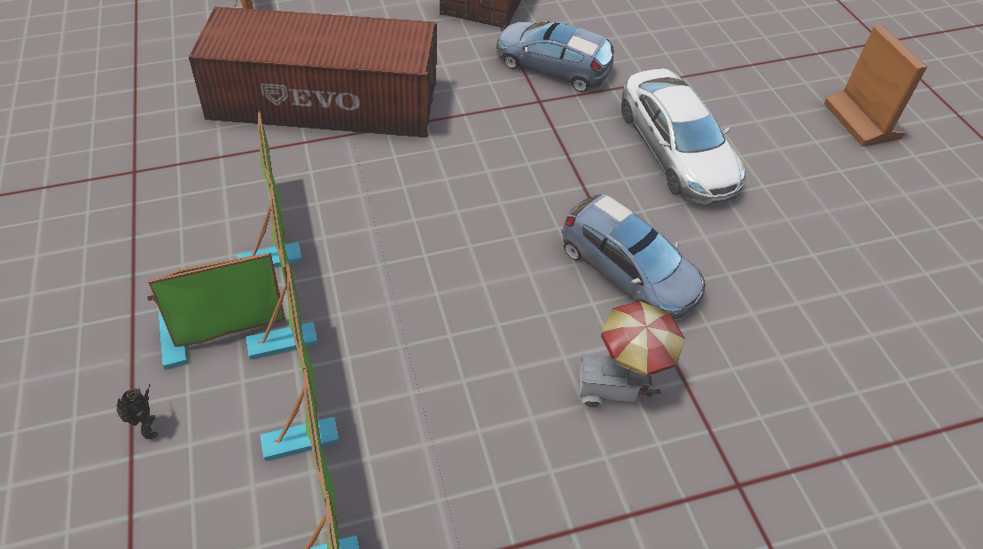
DECISION TO MOVEMENT
Notes:
Before we dive into the code I want to explain what the code does.
Say we have this level with a bot over here and he...

Slide 5
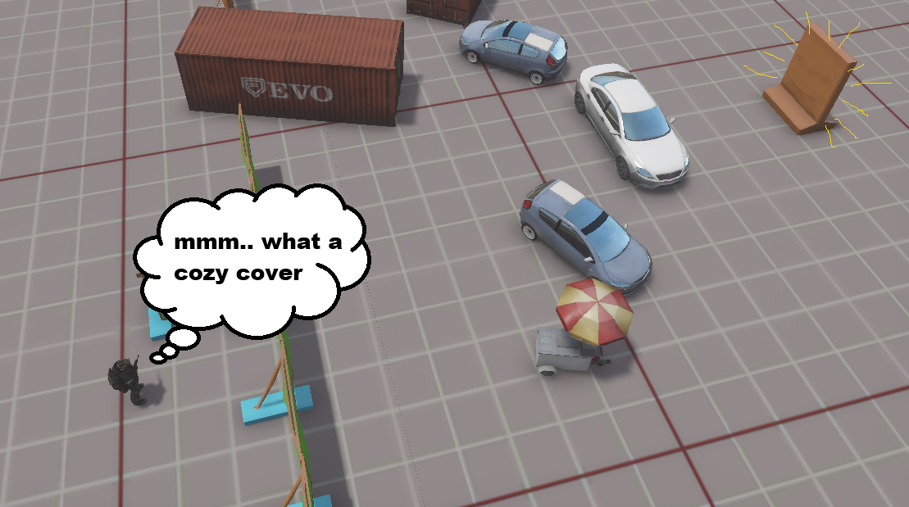
DECISION TO MOVEMENT
Notes:
... _decides_ to go into cover over here. The pathfindeing needs to find a path to get from A to B and then it’s the animation system’s responsability to follow this path.
What we have at our disposal is a nav mesh. It looks like this

Slide 6
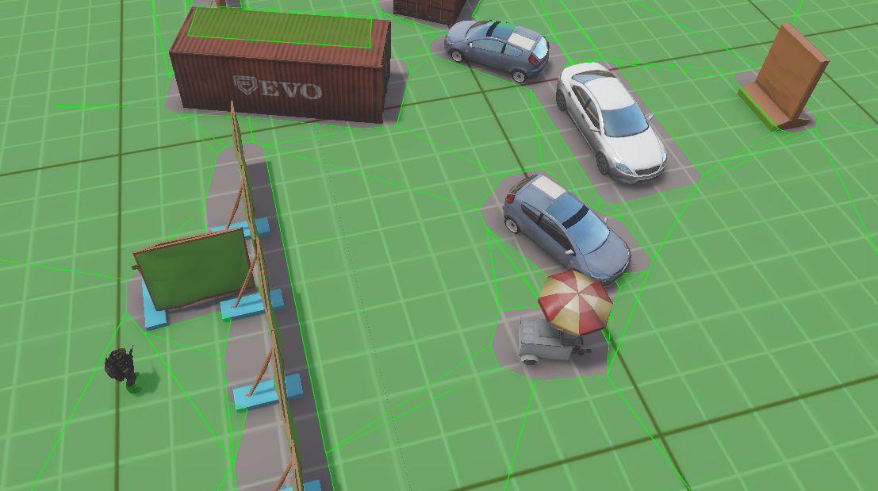
DECISION TO MOVEMENT
Notes:
It’s a set of 3D polygons which describes where bots can walk.
NavPower does a search in this mesh to figure out how to get from A to B.

Slide 7
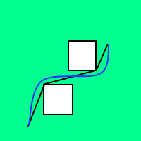
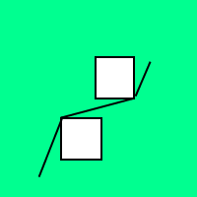
DECISION TO MOVEMENT
Notes:
It returns a path, a list of straight lines that you should walk along to get to your destination.
But humans do not walk on perfectly straight lines, we tend to move in a smoother fashion.
The animation system wants to diverge a bit from the path to look natural.
If have two obstacles and and a path that looks like this, the animation system might want to move more like the blue line
So to give the animation system a bit of freedom to move around...

Slide 8
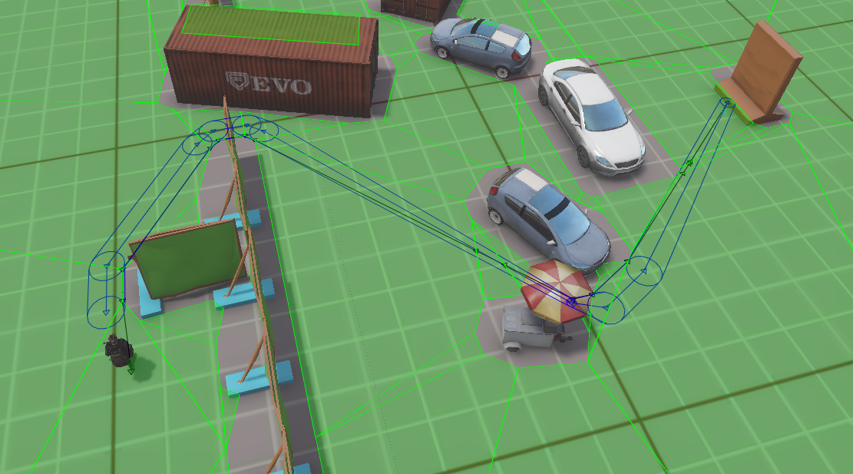
DECISION TO MOVEMENT
Notes:
... we build a corridor the animation system can move within.
So we move points away from corners a bit, give them a radius which says how tight the passage is.
We also drop some unnecessary points that the pathfinding system produces

Slide 9
NAVPOWER OPERATIONS
Find path
Load / unload nav mesh section
Add / remove obstacles
Path invalidation detection
Can go-tests
“Raycasts”, circle tests, triangle tests
Notes:
Finding a path from A to B is the most important operation that NavPower does.
Naturally we load and unload the nav mesh. The nav mesh is split into a grid to support incremental rebuilds.
We can add and remove obstacles that actually cut up the nav mesh at run time. We use it for slow moving vehicles & bangers so bots can walk around them. We might use them for destruction too, but pretty heavy operation.
We detect if a path has gotten blocked by an obstacle, so we can pathfind again
We ask NavPower if it’s possible to go from point A to point B. When AI needs to select a random position he can first test and see that he can reach it before he pathfinds.
We also perform a kind of ray casts, and tests to see if circles and triangles can fit onto the nav mesh.
Now, to get good instruction and data cache locality inside NavPower we want to collect these operations and process them in a batch.
Each frame we collect all pathfinding requests and process them together, collect all obstacles you want to add and feed them to NavPower.

Slide 10
ABSTRACTIONS
Pathfinder - find path, path invalidation, circle tests, raycasts
Random position generator - can go-tests
Manager - load nav mesh, obstacles, destruction, updates
Left some raycasts synchronous
Notes:
When we changed our pathfinding implementation ...
I started by goiing through all AI code and looked at how we used pathfinding. I simplified some things, disabled some others (frontline cover search) and abstracted the remaining use cases into three things
First we have the pathfinder. It allows you to find paths, keeps track that they don’t get invalidated and they also build the corridors.
Then there’s the random position generator. Each bot keeps a few randomized positions around that it know it can reach.
Finally we have the global manager. It loads &unloads nav meshes. It creates&removes obstacles, it’ll handle destruction, also updates the other thingies
Few synchronous raycasts in some AI behaviours that was a bit tricky to collect and batch process. They didn’t run very often, just not worth the worth the effort, let them be synchronous

Slide 11
Pathfinder INTERFACE
interface Pathfinder
{
public:
virtual PathHandle* findPath(const PathfindingPosition& start,
const PathfindingPosition& end,
Optional<float> corridorRadius,
PathHandle::StateListener* listener) = 0;
/// More efficient version of findPath when start is the end of a previous path
///
/// @pre lastPath->getState() == PathHandle::ValidPath
virtual PathHandle* findPathFromDestination(PathHandle* lastPath,
const PathfindingPosition& end,
Optional<float> corridorRadius,
PathHandle::StateListener* listener) = 0;
virtual void releasePath(PathHandle* path) = 0;
virtual bool canGoStraight(Vec3Ref start, Vec3Ref end, Vec3* collision = nullptr) const = 0;
};
Notes:
The patfindiner gives you a path from start to end and you can optionally build a corridor around it.
It returns a handle which we will look at soon
Then there is a more efficient versions which continues to search from the end of a previous path.
When you’ve reached your destination you release your path and the pathfinder will stop checking if the path has been invalidated.
Finally I’ve exposed these synchronous ray cast that some behaviours needed here.

Slide 12
PATH HANDLE
typedef fixed_vector<Vec3, 16> WaypointVector;
typedef fixed_vector<float, 16> WaypointRadiusVector;
struct PathHandle
{
enum State {ComputingPath, ValidPath, NoPathAvailable, RepathingRequired};
interface StateListener {
virtual void onStateChanged(PathHandle* handle) = 0;
};
PathHandle() : waypoints(pathfindingArena()), radii(pathfindingArena()) {}
WaypointVector waypoints;
WaypointRadiusVector radii;
State state;
};
Notes:
The path handle is just a struct. It consists of a bunch of waypoints, the radii of the corridor and a state.
Pretty typical pattern. You have a fixed set of handles that you reuse, so you don’t need to do any memory allocations. Ask for a handle, communicate by both parties polling and writing to the handle.
But in this case we have an OO-style listener? Why don’t I poll state variable for updates?
Well, I want to minimize latency and make sure that the animation system gets the result as soon as possible. But it’s not too bad, I collect and call all onStateChanged calls at the same time = good cache coherency

Slide 13
PATH HANDLE
typedef eastl::fixed_vector<Vec3, 16> WaypointVector;
typedef eastl::fixed_vector<float, 16> WaypointRadiusVector;
struct PathHandle
{
enum State {ComputingPath, ValidPath, NoPathAvailable, RepathingRequired};
interface StateListener {
virtual void onStateChanged(PathHandle* handle) = 0;
};
PathHandle() : waypoints(pathfindingArena()), radii(pathfindingArena()) {}
WaypointVector waypoints;
WaypointRadiusVector radii;
State state;
};
Notes:
Fixed_vectors here are growable. If there’s less than 16 waypoints, which it is in 98% of the cases, they will use the memory allocated inside the path handle. If 16 not enough, this space is wasted because they need to allocate a contigous chunk of memory elsewhere. If it overshoots, allocate memory inside the pathfindingArena(). This is good because we won’t fragment other systems. We can more easily track memory usage and fragmentation one system at a time.
These allocations have nasty life time 2-10 seconds -> causes a lot of fragmentation

Slide 14
NAVPOWER PATHFINDER
class NavPowerPathfinder : public Pathfinder
{
public:
virtual PathHandle* findPath(...) override;
virtual PathHandle* findPathFromDestination(...) override;
virtual void releasePath(...) override;
virtual bool canGoStraight(...) const override;
void updatePaths();
void notifyPathListeners();
private:
bfx::PolylinePathRCPtr m_paths[MaxPaths];
PathHandle m_pathHandles[MaxPaths];
PathHandle::StateListener* m_pathHandleListeners[MaxPaths];
u64 m_usedPaths;
typedef eastl::fixed_vector<PathHandle*, MaxPaths, false> PathHandleVector;
PathHandleVector m_updatedPaths, m_updatedValidPaths;
};
Notes:
Let’s look at the pathfinder implementation.
The updatePaths function polls all navpower paths, creates the corridor for them and then copies the result to the PathHandles.
notifyPathListeners simply notifies all path listeners whose path handles have changed state.
It keeps an array of all the NavPower paths it needs.
It a number of PathHandles and pointers to path handle listeners too.
You use the same index into all of these containers, i.e. The NavPower path number 4 is associated with PathHandle 4 and PathHandle listener nr 4.
There is a bitmask which says which of these indices in currently use.
There are also some _non-growable_ fixed_vectors that contain all the paths that has been update this frame.
All of these containers store their contents inside NavPowerPathfinder. Their storage is pre-allocated, sizes are fixed. You overshoot, you crash. The Full control over memory usage, no allocations, no fragmentation and very good data locality.
But you should be careful so you don’t consume too much memory. It’s good practice to do a rough estimate on how big these containers are. Sizeof(NavPowerPathfinder) ~ 25kb

Slide 15
CORRIDOR STEP
typedef eastl::vector<CorridorNode> Corridor;
ScratchPadArena scratch;
Corridor corridor(scratch);
corridor.resize(navPowerPath.size()); // Will allocate memory using the scratch pad
Copy all new NavPower paths -> temporary representation
Drop unnecessary points
Corridor adjust paths who requested it
Copy temporaries -> PathHandles
Notes:
Let’s go a bit deeper and look at the corridor. It does four things:
It copies all new navpower paths to an intermediate representation suited for corridor calculations.
For each path we then it drops all of those extra points that NavPower generated each time we crossed a nav mesh polygon
Next, we create the actual corridor for the paths that supplied the optional corridor radius
Finally we copy the results to the PathHandles
Now, ordinary Heap allocations are pretty expensive. They have to be threadsafe _and_ they have to find a good slot in the perhaps fragmented memory you have left. In this case we just want some temporary memory, use it a short while, and then throw it away.
And that’s exactly what the scratch pad is for. The scratch pad is a chunk of memory we’ve set aside for short lived allocations. It uses a simple & cheap linear allocator. It allocates a fairly large block, I think it’s 128kb, when you create a ScratchPadArena. Whenever you allocate something it just increments a pointer. And when it goes out of scope, it’s destructed will return the entire block in one call. It never tries to reclaim the memory you release, so if you new and immediately delete a pointer that memory wont be released until you destroy the scratchpadarena.
A typical use case is to create a ScratchPadArena on the stack and pass it to a container constructor.
This container will then use this allocator you gave it when you call push_back/insert/resize or other operations that needs to allocate memory.
Step number one will create several corridors on the scratch pad. Let’s look at the code for step 2,3 and 4

Slide 16
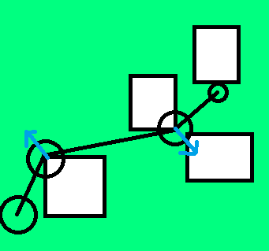
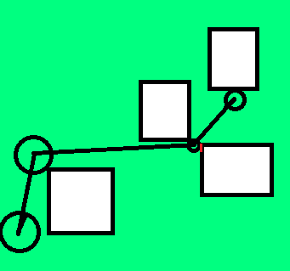
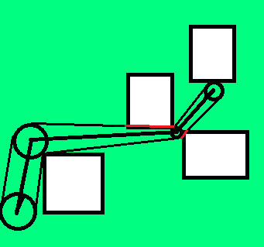
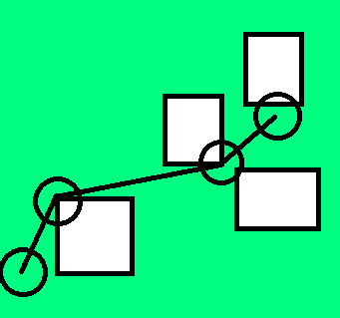
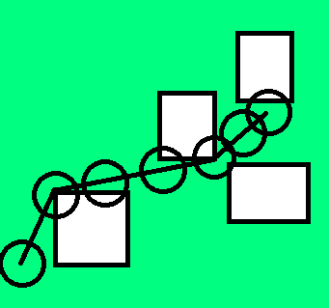
CORRIDOR STEP 2-4
const CorridorHandleVector::iterator allBegin = all.begin(), allEnd = all.end();
const CorridorHandlePtrVector::iterator adjustBegin = adjust.begin(), adjustEnd = adjust.end();
for (CorridorHandleVector::iterator it=allBegin; it!=allEnd; ++it)
dropUnnecessaryPoints(it->corridor, scratchPad);
for (CorridorHandlePtrVector::iterator it=adjustBegin; it!=adjustEnd; ++it)
shrinkEndPoints((**it).corridor, m_id);
for (CorridorHandlePtrVector::iterator it=adjustBegin; it!=adjustEnd; ++it)
calculateCornerDisplacements((**it).corridor);
for (CorridorHandlePtrVector::iterator it=adjustBegin; it!=adjustEnd; ++it)
displaceCorners((**it).corridor, m_id);
for (CorridorHandlePtrVector::iterator it=adjustBegin; it!=adjustEnd; ++it)
shrinkSections((**it).corridor, m_id);
for (CorridorHandleVector::iterator it=allBegin; it!=allEnd; ++it)
copyCorridorToHandle(it->corridor, *it->handle);
}
Notes:
We have two vectors, one contain all of the paths in this intermediate corridor representation. The other contain pointers to all of corridors that need adjustment.
Then we just loop over all of the corridors and do one operation at a time.
One of these corridors might look like this. We have a start point and an end point and a bunch of intermediate points with the corridor radius set originally.
First we drop all intermediate points for all corridors..
Shrink. Haven’t actually implemented yet
The good thing about doing it this way is that we do all circle test at the same time, then we do all corner displacements and so on.
Writing the code this way is not a whole lot more complicated, you just add some extra for loops

Slide 17
NavPOWER MANAGEr
void NavPowerManager::update(float frameTime)
{
m_streamingManager.update();
m_destructionManager.update();
m_obstacleManager.update();
bfx::SystemSimulate( frameTime );
for (PathfinderVector::const_iterator it=m_pathfinders.begin(), ...)
(**it).updatePaths();
for (PathfinderVector::const_iterator it=m_pathfinders.begin(), ...)
(**it).notifyPathListeners();
for (PositionGeneratorVector::const_iterator it=m_positionGenerators.begin(), end = ...)
(**it).update();
}
Notes:
Let’s zoom out and what the manager does each update
Adds and removes all obstacles
This call does we pathfinding&string-puling
Then we poll the pathfinding handles and do the corridor adjustments
We have several pathfinders, on for the infantry nav mesh, one for a tank nav mesh
Then we update all path listeners
Then we generate random positions. So they will be available

Slide 18
BATCHING BENEFITS
Keep pathfinding code/data cache hot
Avoid call sites cache running cold
Easier to jobify / SPUify
Easy to timeslice
Notes:
The biggest performance benefit of doing calculation this way is on heavy frames. It’ll be much cache friendlier to handle a frame where you spawn 10 vehicles and they all create an obstacle each.
You keep running the same code over and over and it’s hot. If you instead would add an obstacle immediately when you spawn a vehicle, you would go deep into NavPower, run into lots of cache misses and once you return back to spawn you might have evicted most spawn related code and data because you touched so much code and data inside NavPower.
Even if you just have say two path requests, one destruction event and some random positions to generate. Well then you will keep generic NavPower system code hot if you execute them together. And more importantly, you won’t make AI decision making code&data cold by taking deep dives into a call stack.
Easier to jobify/timesilce
Not a lot of extra work to write code this way, sometimes it’s even simpler and takes less code. I.e. AI decision making is easy to understand if we can see all its inputs and all its outputs.

Slide 19
Asynchronous
Manager
Random position generator
Pathfinder
Collect destruction messages, process in batch
Runs ~1/sec. Allows synchronous decisions
Decision making assumes success
Notes:
All pathfinding abstraction are asynchronous, but in different ways
Most of what the manager does is pretty natural to do once per frame. One thing it does it collect destruction messages and then batch process
Random position generator runs about
We’ve looked at how the pathfinder is implemented but we haven’t talked about how it’s used.
AI Decision making decides it want to go somewhere, goes into its movement behaviour and happily assumes it moves. And in 99% of the cases it will work, cause either scripted waypoints or randomly selected positions we can reach. In the cases it doesn’t, well the AI will think he’s moving for a frame or two but that’snot really a problem.

Slide 20
LESS SIMPLIFIED ARCHITECTURE
SCRIPTING
SERVER
CLIENT
AI DECISION MAKING
PATH FOLLOWING
PATHFINDING
NAVPOWER
DRIVING
LOCOMOTION
LOCOMOTION
Waypoints
VEHICLE INPUT
Waypoint Data
ANIMATION
Corridor Radii
Notes:
If you want to look at the real code there’s a bit more functionality and layers you should know about.
You can input scripted sequences, there is a path following layer, you can steer both vehicles and infantry.
We use a server-client model and we only run AI and pathfinding on the server.
Beside from actual waypoints we have the corridor radius and scripted data. The scripted data informs the bot that this waypoint is a vault point or that the bot should stop and pause a few seconds.
We don’t really use them until in the locomotion code. So each step here only works with the data it needs.
Even in the object oriented part of the code, where there is one instance per bot, the data is represented as three separate vectors and each step only touches the information it needs.
Pathfinding only takes waypoints as input in the form of start and ends of a scripted segment. And it returns new waypoints and radii. These radii are just passed on to the locomotion client.
When you have this many steps and you start making them asynchronous you have to be careful to not introduce needless latency.

Slide 21
My precious latency
Each server tick
1. Each AI decision making
2. Pathfinding manager update
All pathfinding requests
All corridor adjustments
All PathHandle notifications -> path following -> server locomotion
3. Network pulse. Server locomotion -> client locomotion
4. ...rest of tick
Notes:
Each server tick we first let all AI think which may result in path requests
Directly afterwards we update the pathfinding manager.
It will process all pathfinding requests, then do all corridor adjustments, then do all path handle notifications.
These are OO-style synchronous callbacks, so they will immediately go down thorugh the path following layer and into the server locomotion component and set data.
Go back and forth up and down. Not a problem, small often identical stack, cache will be hot!
The network pulse will send the data off to the client side.
So there is no extra latency involved here

Slide 22
Asynchronous EXAMPLES
Callbacks. Delay? Fire in batch?
Handle+poll instead of callbacks. Poll in batch.
Record messages, process all once a frame
Check success / failure next frame
Pre-calculate what you’re likely to need
Con: Callstack won’t tell you everything.
...but can we afford deep callstacks?
Notes:
Let’s recap on some of the super simple patterns we’ve seen.
Callbacks are the classical OO async mechanism. When we use them we do not have to fire them immediately. If you expect several of the same type to happen each frame or you know they will dive into a really deep callstack or touch a lot of data, it can be worthwhile to delay them.
You can use handles and polling instead of callbacks. Checking a flag is much cheaper than a virtual callback.
Similar for messages, you do not have to act immediately.
If it’s not too difficult to recover from failure, you can just assume an operation succeeds if you need to make it asynchronous
In some cases you can even pre-calculate information you’re likely to need.
Can’t place break point and get vertical slice of 10 systems... But...can we really afford such deep calls given the price of memory access?

Slide 23
RESOLVE EARLY
void Bot::changeVehicle(const ServerEntryComponent* entry)
{
...
m_pathFollower = entry->owner()->
getFirstComponentOfType<ServerPathFollowingComponent>()->getPathFollower();
}
Notes:
Other than pre-calculating things you should also pre-fetch it.
When you’re writing data-oriented code you have a clear set of inputs and you make sure you have them available before you start working. We can often do the same thing in OO code.
For instance we need to use a PathFollower in basically every frame in AI decision making code. It’s hidden deep in the component hiearchy. So instead of digging it out each time we need it, we do it once when the bot changes vehicle and the AI code will then use this reference to access the pathfollower

Slide 24
BE NICE TO YOUR MEMORY ☺
new / push_back() / insert() / resize()
Stop and think!
Where is the memory allocated?
Pre-allocated containers?
Scratch pad?
Can I resize()/reserve() immediately?
Can I use Optional<T> instead of ScopedPtr<T>?
Can I use vectors instead of list / set / map?
Notes:
New/push_back(): Good place to stop and think
Where is the memory allocated? Did I specify an arena?
Can I use pre-allocated containers and skip allocations alltogether?
If not, can I use the scratch pad?
Can I resize or reserve the memory immediately, so I don’t have to grow it incrementally and make many small allocations.
Optional is a preallocated container with 0 or 1 element, can I use that instead of a ScopedPtr and save a dynamic allocation?
Once you’ve done this 5 times you will do it in your sleep ☺

Slide 25
Let’s START MOVING
Let’s not abandon OO nor rewrite the world
Start small, batch a bit, resolve inputs, avoid deep dives, grow from there
Much easer to rewrite a system in a DO fashion afterwards

Slide 26
SUMMARY
AI decision making – pathfinding – animation
Code: Handles, arena, scratch pad, fixed_vector, batch processing
Latency analysis, async patterns
Think about depth/width of calls, try stay within your system, resolve early, new/push_back() = think
Notes:
We first looked at how AI decision making, pathfinding & animation worked together
We saw how the pathfinding use cases were grouped into some async abstractions
We looked at a lot of code
We saw a latency analysis

Slide 27
QUESTIONS?
johan.torp@dice.se

